Slide 1


Evolution of Antibody Immunity of SARS-CoV2
Gaebler, et al., 2021
Notes:
Intro 2-5: Harsha
Methods 6-11: Paige
Fig1 12-14: Paige
Fig2 15-19: Harsha
Fig3 20-23: Harsha
Fig4 24-27: Paige
Fig5 28-29: Paige
Wrap-up: Harsha

Slide 2
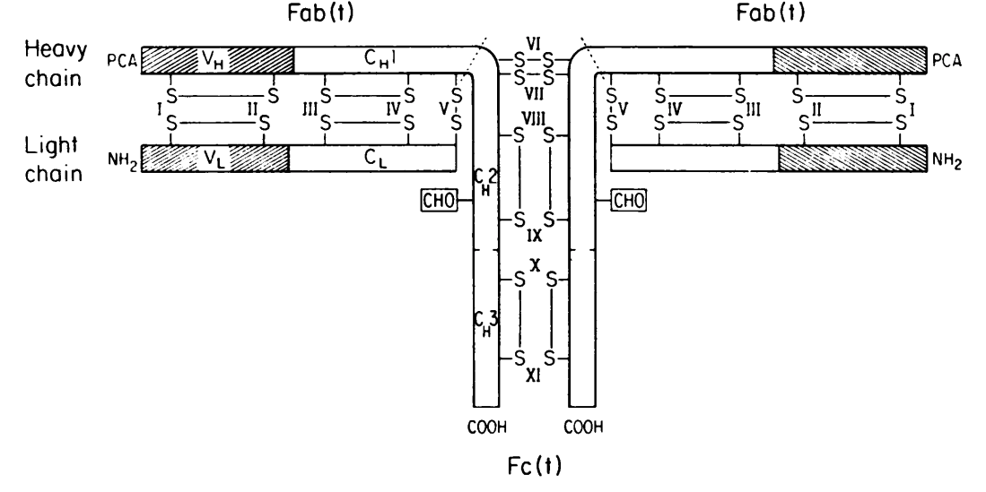
Characterizing an Immunoglobulin
Adapted from Edelman GM, Cunningham BA, Gall WE, Gottlieb PD, Rutishauser U, Waxdal MJ. The covalent structure of an entire gammaG immunoglobulin molecule. Proc Natl Acad Sci U S A. 1969 May;63(1):78-85
Notes:
First characterization of immunoglobulin in 1969 by Edelman. Light and heavy chain sequence lengths are 214 and 446, respectively.
Over-all arrangement of chains and disulfide bonds of human yGl immunoglobulin Eu. Half-cystinyl residues are numbered I-XI; numbers I-V designate corresponding residues in light and heavy chains. PCA: pyrollidonecarboxylic acid
CHO: carbohydrate
"Fab(t)" and "Fc(t)" refer to fragments produced by trypsin, which cleaves the heavy chain as indicated by dashed lines above haif-cystinyl residues VI. VH, VL: variable regions of heavy and light chains, CL: constant region of light chain. CH1, CH2, CH3: homology regions comprising CH or constant region of heavy chain.

Slide 3
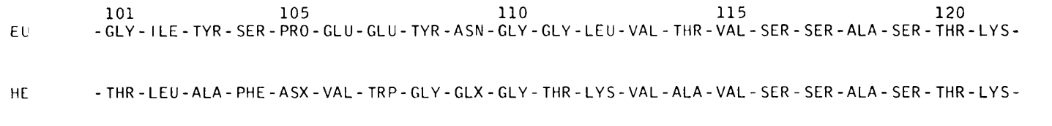
Characterizing an Immunoglobulin
Variable
Constant
Eu: human IgG
He: human myeloid protein
Adapted from Edelman GM, Cunningham BA, Gall WE, Gottlieb PD, Rutishauser U, Waxdal MJ. The covalent structure of an entire gamma G immunoglobulin molecule. Proc Natl Acad Sci U S A. 1969 May;63(1):78-85
Notes:
Myeloma Protein (He): abnormal antibody (a fragment) produced in excess by abnormal proliferation of plasma cells, leading to M spike
Variable regions are from residue 1 to 114 (at the time). Today, studies show that variability : constant junctions' range between 110 and 130 residue lengths

Slide 4
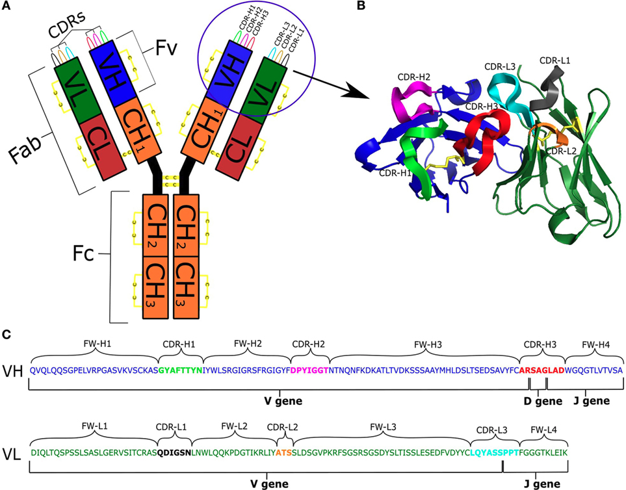
IgG Structure
Kovaltsuk A, Krawczyk K, Galson JD, Kelly DF, Deane CM and Trück J (2017) How B-Cell Receptor Repertoire Sequencing Can Be Enriched with Structural Antibody Data. Front. Immunol. 8:1753
Notes:
CDR – complementary determining region, where antibodies bind to specific antigen
FW – framework regions (supports proper folding)
Antibody:Antigen::Paratope:Epitope

Slide 5
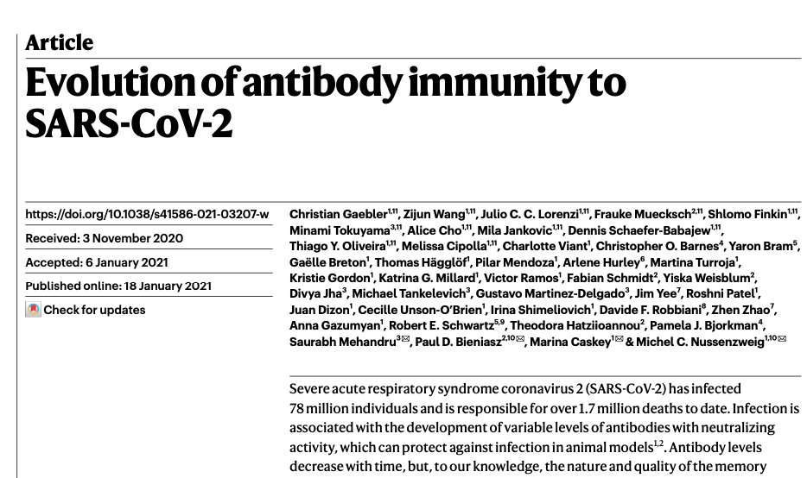

Slide 6




Study Participants
Rockefeller University Hospital (31 Aug-16 Oct 2020)
18-76 years old
Diagnosed with COVID (PCR) or in close contact
Most were residents of NYC or tri-state area

Slide 7


Methods
ELISA (enzyme-linked immunosorbent assay)
Flow cytometry
smFISH (single molecule fluorescence in situ hybridization)
Notes:
EC- effective concentration
IC- inhibitory
NT-Neutralization
Monoclonal vs polyclonal antibodies
Somatic hypermutations

Slide 8
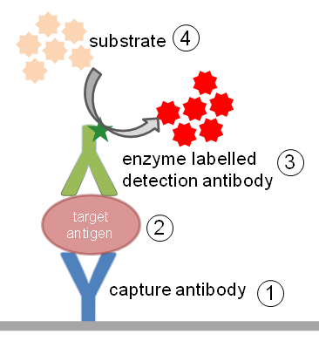
ELISA
https://www.immunology.org/public-information/bitesized-immunology/experimental-techniques/enzyme-linked-immunosorbent-assay
Notes:
https://www.immunology.org/public-information/bitesized-immunology/experimental-techniques/enzyme-linked-immunosorbent-assay
Capture antibody binds to plate
Add sample
detection antibody binds to target
Substrate changes the color, which is then read but a spectrophotometer
EC- effective concentration
IC- inhibitory
NT-Neutralization

Slide 9
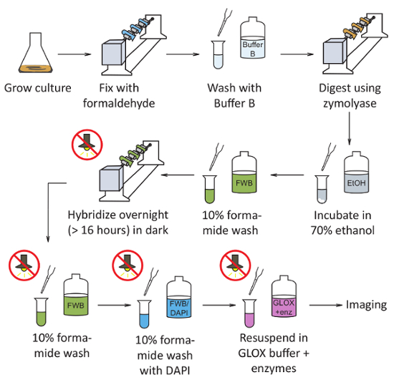
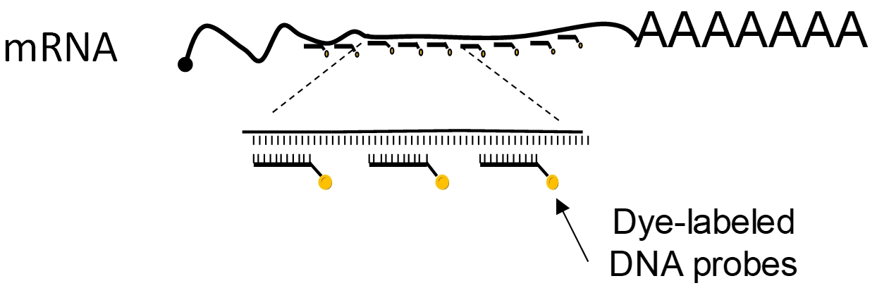
smFISH
https://dx.doi.org/10.3791/57774
Notes:
https://dx.doi.org/10.3791/57774
powerful technique to study gene expression in single cells due to its ability to detect and count individual RNA molecules

Slide 10
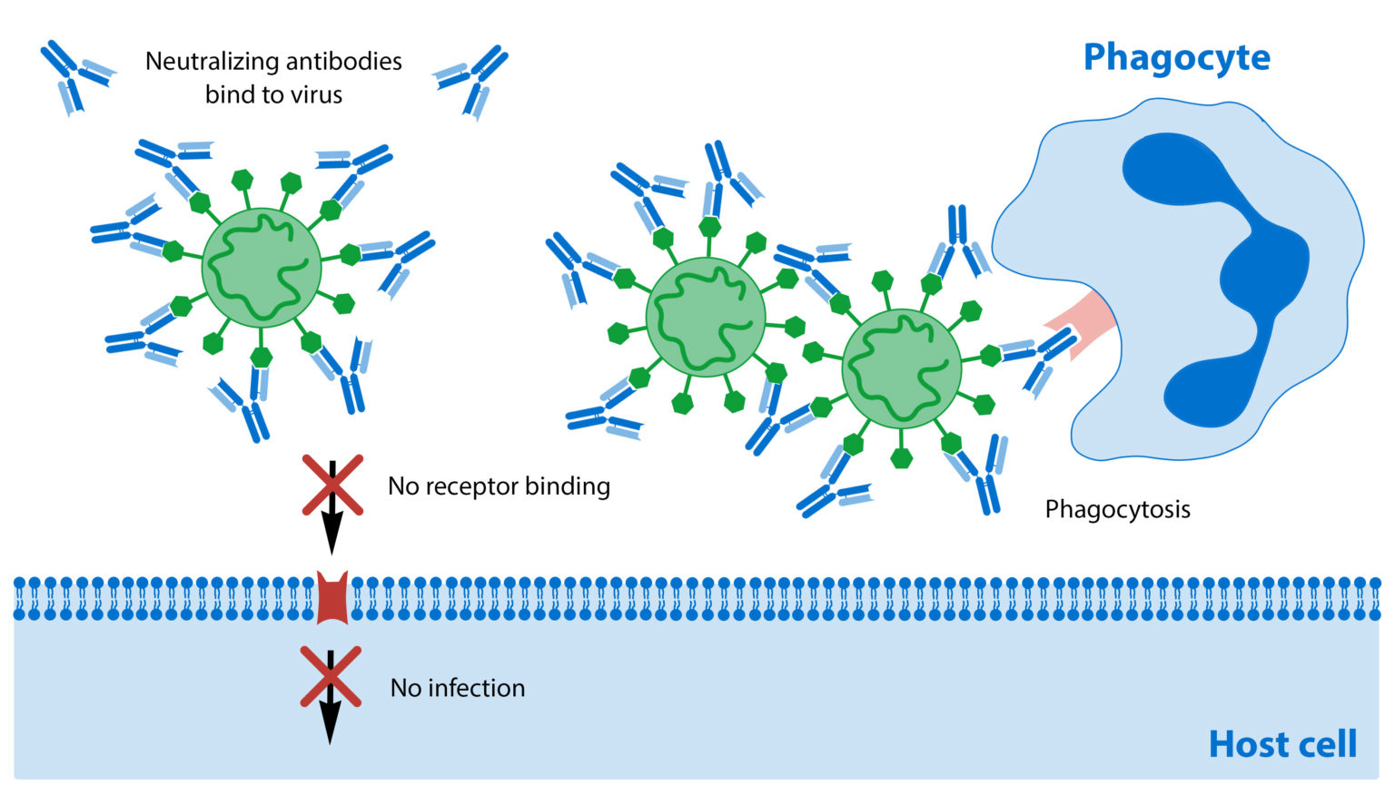
Antibody Neutralization and Opsonization
https://www.fluidic.com/resources/what-are-neutralizing-antibodies/
Notes:
https://www.fluidic.com/resources/what-are-neutralizing-antibodies/
Antibody optimization

Slide 11
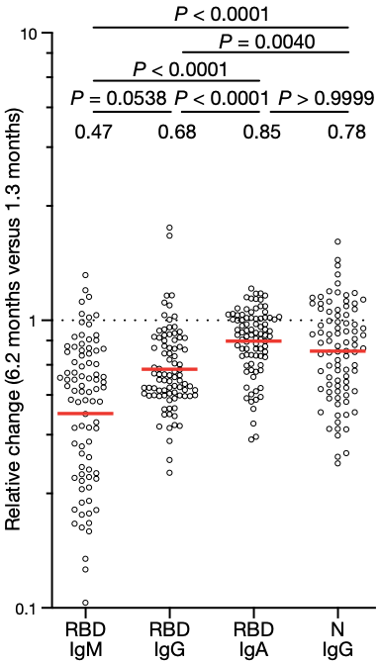
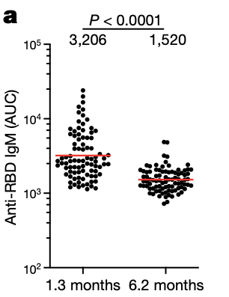
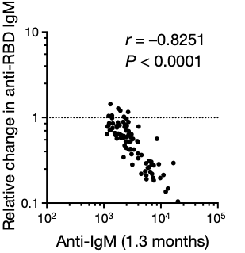
Immunoglobin Levels Decreased After Infection
Notes:
IgM-first line of defense, blood and tissue
IgG- prevent infection, blood
IgA- fight off infection, mucus membranes
Researchers looked at plasma reactivity to RBD using ELISA

Slide 12
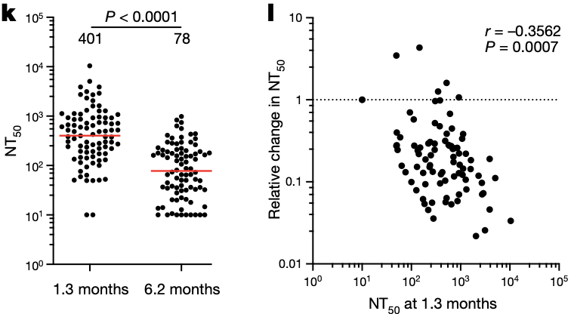
Neutralization Decreases Over Time
Ig’s are progressively decrease over time
Neutralization decreases over time
NT₅₀ = neutralization titer
Notes:
They measured plasma neutralizing activity using an HIV-1 virus pseudotyped with the SARS-CoV-2 spike protein
Consistent with other reports, the geometric mean half-maximal neutralizing titre (NT50) in this group of 87 participants was 401 and 78 at 1.3 and 6.2 months, respectively—representing a fivefold decrease
This slide includes the “Take Home Information”

Slide 13
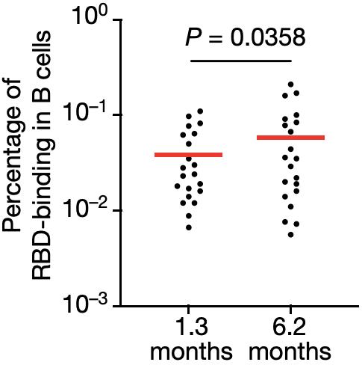
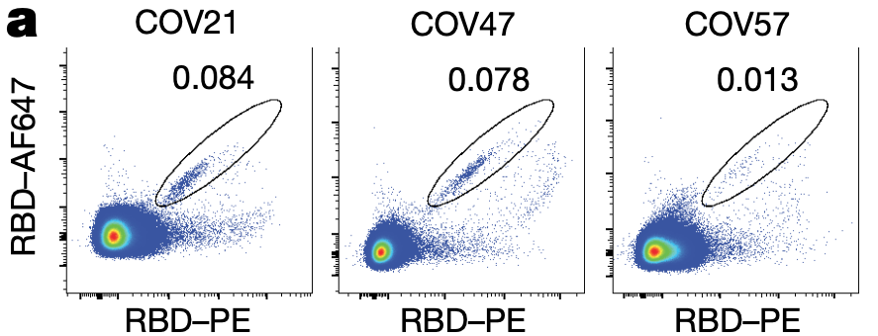
Isolated B cells Increase RBD-binding Memory with Time
Notes:
Next, they wanted to identify and count the circulating SARS-CoV-2-specific memory B cell compartment, they used flow cytometry to isolate individual B lymphocytes with receptors that bound to RBD1
the percentage of RBD-binding memory B cells increased marginally between 1.3 and 6.2 months in 21 randomly selected individuals

Slide 14
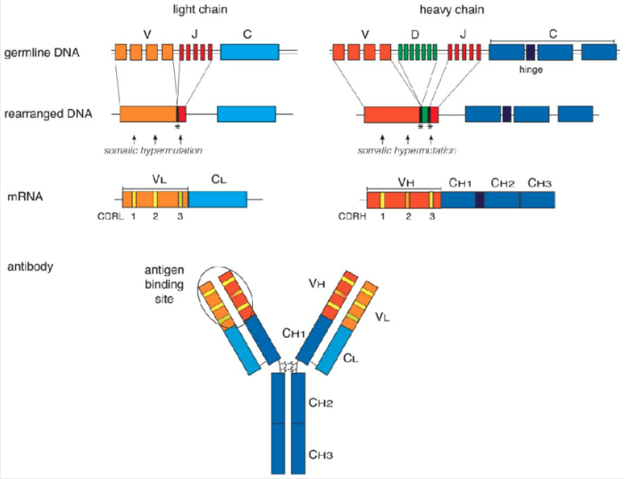
Somatic Recombination
Feederle R, Schepers A. Antibodies specific for nucleic acid modifications. RNA Biol. 2017 Sep 2;14(9):1089-1098.
Notes:
All Happens in Bone Marrow
Heavy Chain
Lymphoid SC→ Pro-B cell ; DJ
Pro-B cell → Pre-B cell ; V-DJ
Light Chain
Pre-B cell → Immature C cell ; VJ
Immature undergoes periphery antigen RNA processing to finally present first immunoglobulins

Slide 15
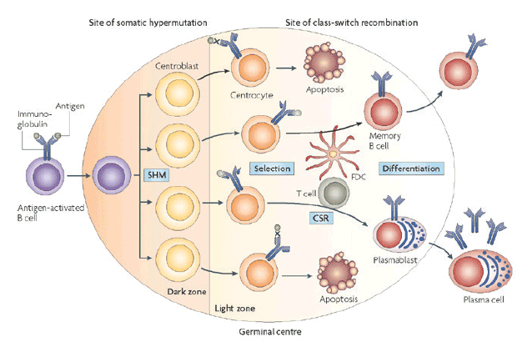
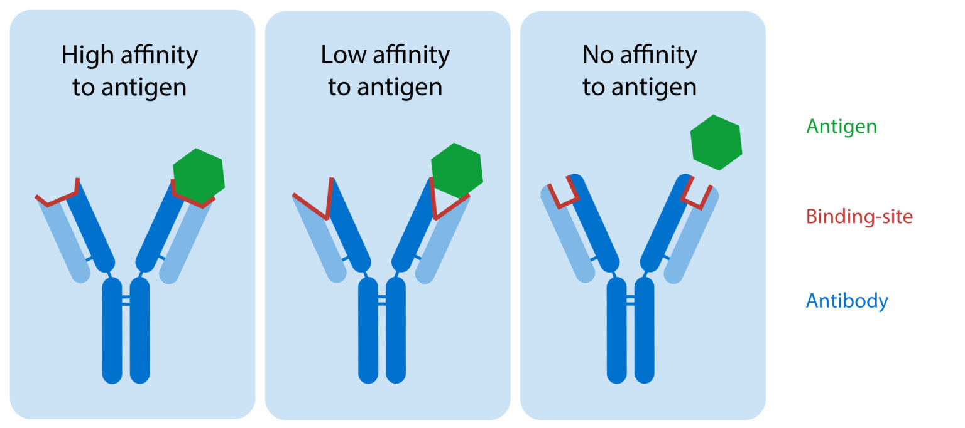
Somatic Hypermutation
Immature → Mature B cell
Translocates from bone morrow to periphery lymphoid organs
Generates specificity for epitopes upon antigen binding
Alters B-cell molecular basis of increased binding affinity
AID (activation-induced cytidine deaminase)
Notes:
https://oncologypro.esmo.org/education-library/essentials-for-clinicians/lymphomas/b-cell-diversity
SHM occurs every time B cell encounters an antigen, positively selects for highest affinity antibody. AID introduces point mutations
AID also works on class switching in light zone (Holliday Junctions → DNA loops). Only occurs after first antigen recognition

Slide 16
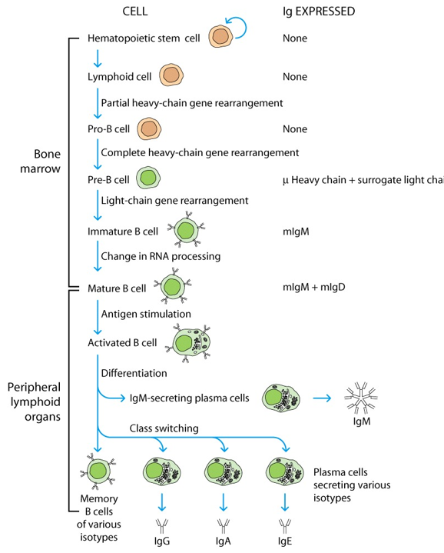
B cell Development
Adapted from conv. w/ Dr. Barton, Austin College

Slide 17
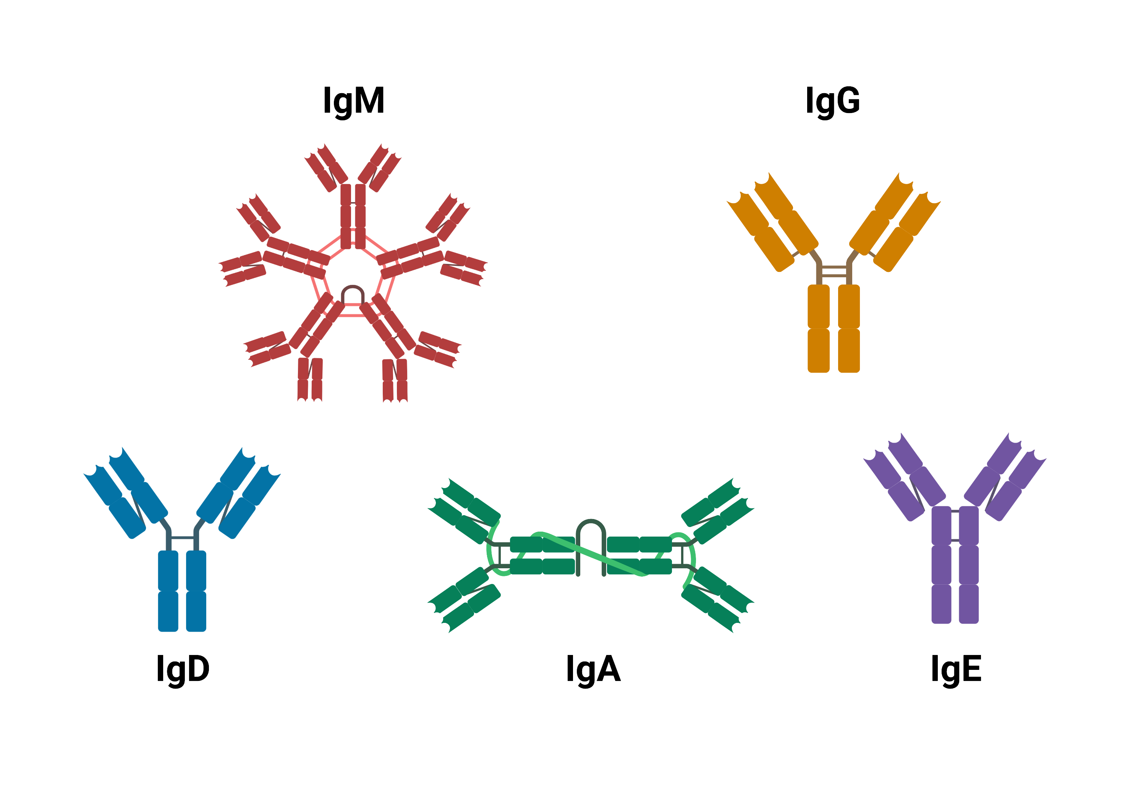
Immunoglobulin Isotypes
Notes:
IgA: found in mucous membranes and from secretive glands (sweat, breast milk, etc); dimerizes after secretion
IgM and IgD: first antibodies in human development, in innate immunity; IgM great for complementation activation. Functions of !gD are unknown, but are being investigated
IgE: involved in allergic and parasitic invasion
IgG: highest opsonizations and neutralization activity ; also only Ig that can pass through placenta

Slide 18
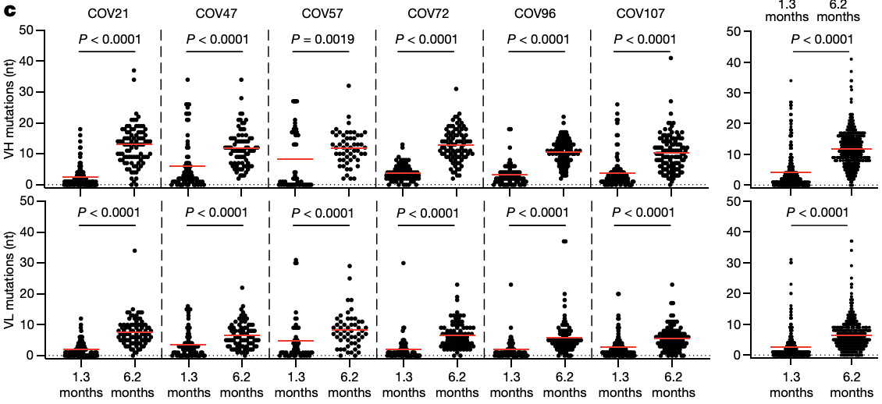
Increased Mean in Nucleotide Mutations
Notes:
VH=Heavy chain
VL=Light chain

Slide 19
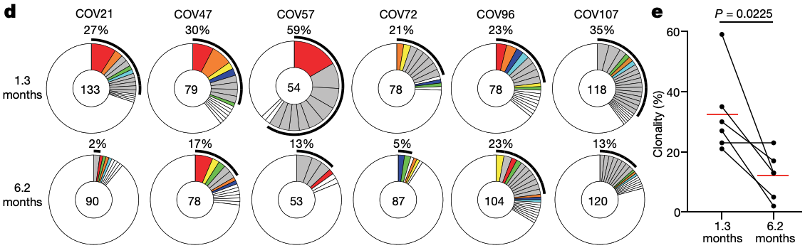
Clonal Composition Varied between Individuals, Collectively Clonality Decreased
Notes:
The number in the inner circle indicates the number of sequences analyzed for the individual denoted above the circle
Pie-slice size is proportional to the number of clonally related sequences
The black outline indicates the frequency of clonally expanded sequences detected in each participant
Colored slices indicate persisting clones (same IGHV and IGLV genes and highly similar CDR3) found at both time points in the same participant
Grey slices indicate clones unique to the time point
White slices indicate singlets found at both time points, and the remaining white area indicates sequences that were isolated once.

Slide 20
Figure 2 Take Home
RBD-binding memory B cells increased between 1.3 and 6.2 months (n=21)
Possible increase in specificity for antigen?
Average number of nucleotide mutations in heavy and light chains significantly increased (n=6)
Mutations correlated with binding specificity?
Overall increased clonal recycling of the B cell memory compartment between two time points in examined subjects
Notes:
the overall clonal composition of the memory compartment differed at the two time points in all the individuals examined

Slide 21
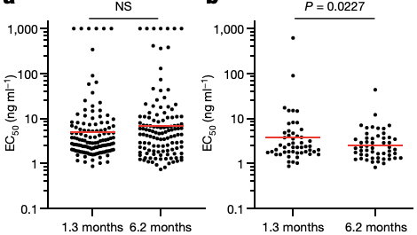
Shared Antibodies Across Time Points Decreased
All Antibodies Present in All Samples
Antibodies that are Present at Both Time Points
EC₅₀= effective concentration
Notes:
EC refers to effective monoclonal antibody concentrations rather than inhibitory (neutralization) concentrations indicated by NT

Slide 22
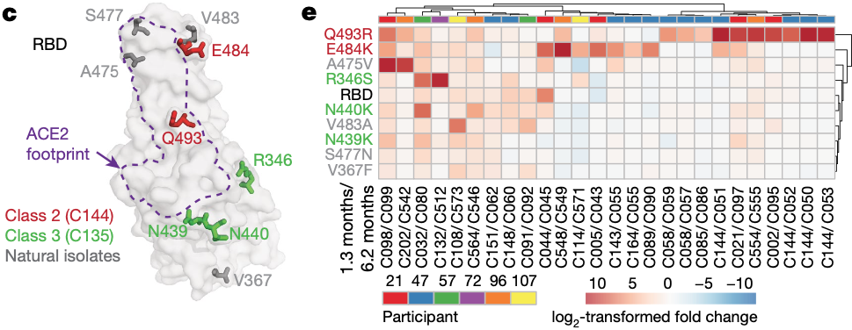
Mutants Chosen to Investigate
Notes:
To determine whether the antibodies expressed by memory B cells at the late time point also showed altered breadth, they compared them to earlier clonal relatives in binding assays using control and mutant RBDs
Covid RDB is a 7-region RBD, allowing it to have frequent opportunities to mutate (Hastie, 2021)
RED- E484K and Q493R were resistant to class-2 antibodies that bind to ACE-2 interaction bridge
GREEN- R346S, N439K, and N440K were resistant to class-3 antibodies that do not directly bind/interfere to the ACE-2 binding
GRAY- V367F, A475V, S477N and V483A mutants of RBD and represent circulating variants that have complete or partial resistance to class 1 and 2 antibodies
log2-transformed relative fold change in EC50 against indicated RBD mutants for 26 antibody clonal pairs obtained at 1.3 and 6.2 months with the most pronounced changes in reactivity.
Overall, the most pronounced increase in binding occurred for mutations affecting the RBD in amino acid positions such as E484, Q493, N439, N440 and R346, which are critical for the binding of class-2 and -3 antibodies

Slide 23
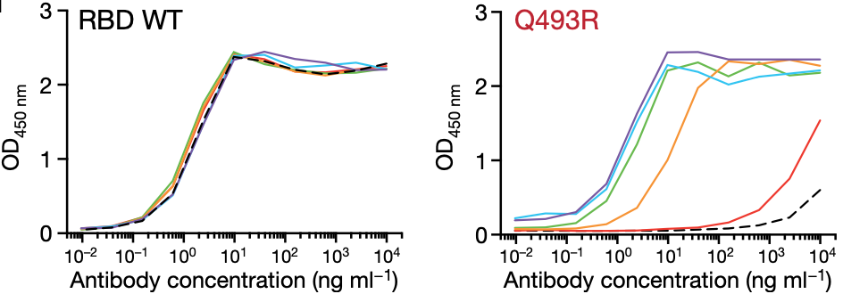
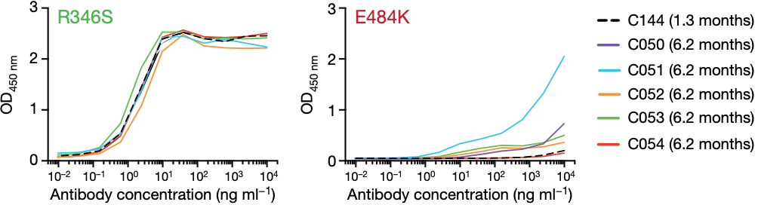
Antibodies were Unable to Bind to Some Mutated RBD
Notes:
C144 (a class-2 antibody recovered at the 1.3-month time point) was unable to bind to RBD(Q493R) or RBD(E484K), but all five of its clonal derivatives collected at 6.2 months bound to RBD(Q493R) and one also showed binding to RBD(E484K)
Graphs show ELISA binding curves for C144 (black dashed line) and its clonal relatives obtained after 6.2 months (C050, C051, C052, C053 and C054) (solid lines) binding to wild-type (WT), Q493R, R346S and E484K RBDs.

Slide 24
Figure 3 Take Home
The number of shared monoclonal antibodies across time diminished
Antibodies demonstrate binding specificity to epitopes of the viral particle’s mutated RDB
Antibodies can evolve to accommodate for continuously mutating virus
Notes:
Hastie, 2022, sent by MingHao; talks the 7-RBD-communities for binding to receptors → Susceptible to a multitude of mutations (leaving antibodies ineffective)
Look at Covid, omicron subvariants BQ1, BQ1.1, etc.

Slide 25
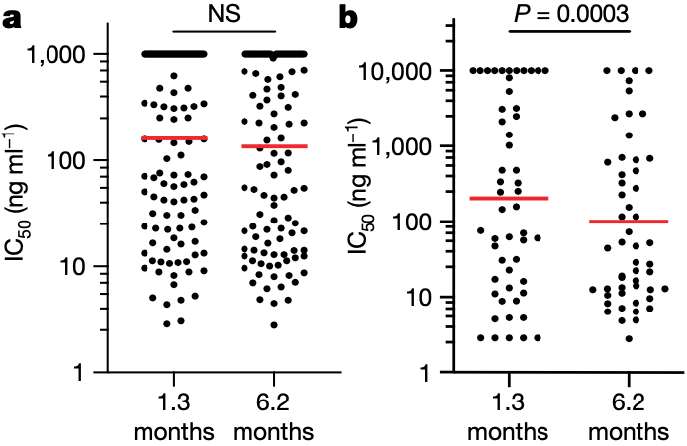
Neutralizing Monoclonal Antibodies Decrease with Time
All Antibodies Present in All Samples
Antibodies that are Present at Both Time Points
IC₅₀ = Inhibitory Concentration

Slide 26
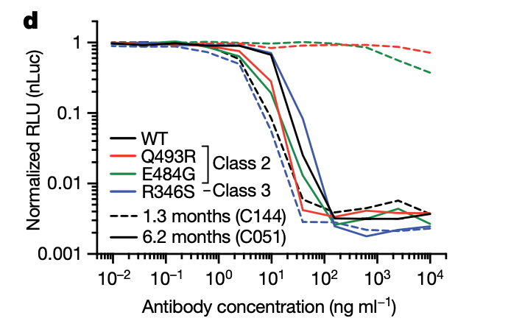
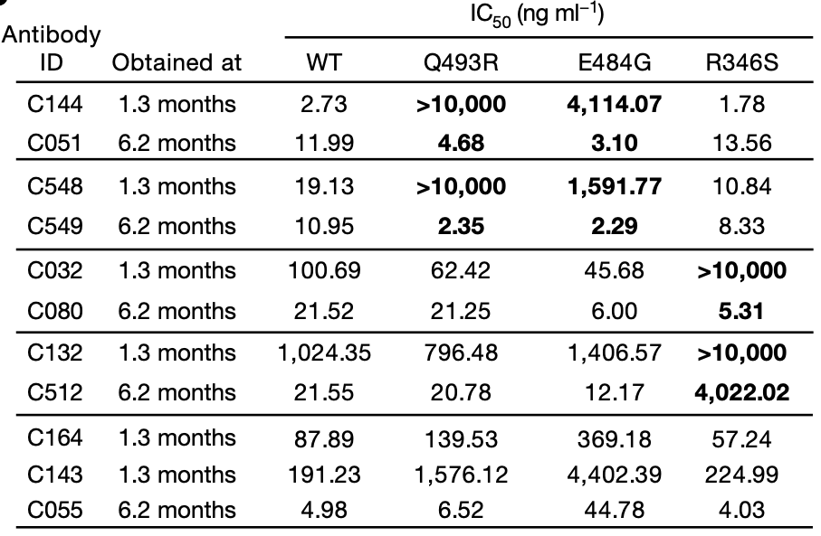
IC₅₀ Values Decrease After 6.2 Months PI for Mutant Variants
RLU = Relative Luminescence Units
Notes:
They tested five representative antibody pairs recovered at the two time points against HIV-1 viruses pseudotyped with E484G, Q493R, and R346S mutant spike proteins
the Q493R and E484G pseudotyped viruses were resistant to neutralization by C144; by contrast, C051 (a 6.2-month clonal derivative of C144) neutralized both variants, with IC50 values of 4.7 and 3.1 ng ml−1, respectively
R346S pseudotyped viruses were resistant to C032, but C080 (a 6.2-month clonal derivative of C032) neutralized this variant with an IC50 of 5.3 ng ml−1

Slide 27
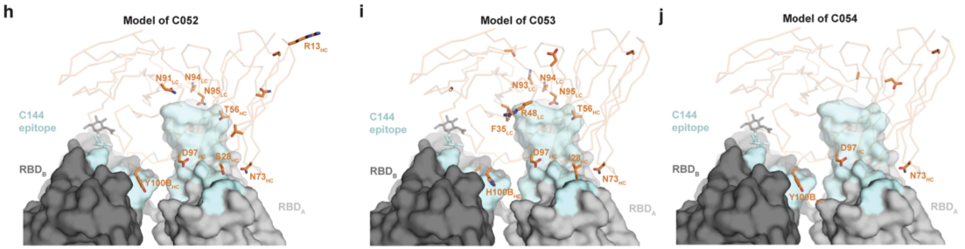
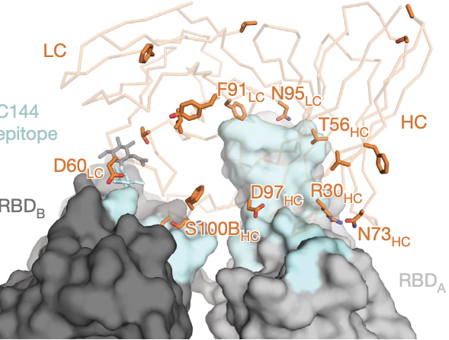
Mutation Varies Directly or Adjacent to RBD
Model of C051
Memory B cells evolved during the observation period, express antibodies with increased neutralizing potency and breadth
Notes:
late-appearing antibodies (for example, C051) had acquired mutations directly in or adjacent to the RBD-binding paratope

Slide 28
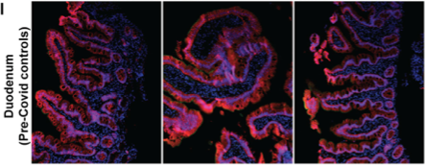
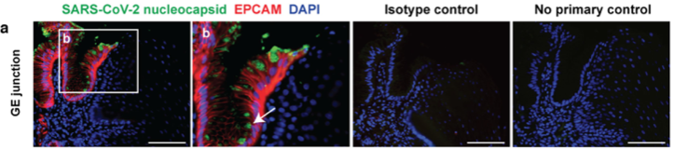
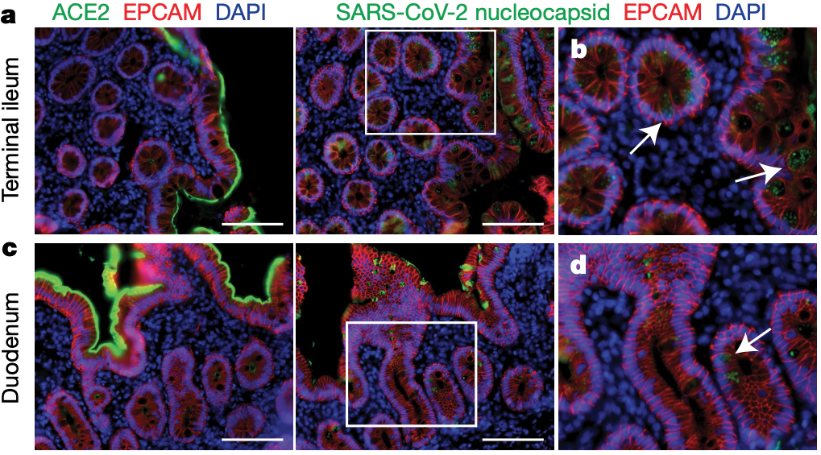
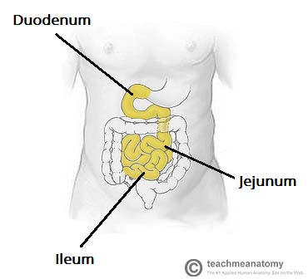
ACE2 & SARS-CoV-2 N Protein are Detected in GI Tract
SARS-CoV-2 replicates in ACE-2 expressing cell in the small intestines
Antigen is persistent in other tissues other than the lungs and mucus membranes
Notes:
When detected, immunostaining was sporadic, patchy, exclusive to the intestinal epithelium and not associated with inflammatory infiltrates
Extended Data 9 pre covid control and other
https://teachmeanatomy.info/abdomen/gi-tract/small-intestine/

Slide 29
Conclusions
Decreased Plasma cell (B cell IG secreting) activity (NT₅₀)
Greater memory B cell binding affinities
More SHM and fewer RBD mutations
Antibodies evolved specificity for mutated viral RBDs (EC₅₀)
Monoclonal antibodies (some) demonstrate neutralization capability at significantly lower concentrations (IC₅₀)
Antigen persistence in intestines promotes continued antibody evolution through maintained FDC-dependent antigen presentation
Contains Peyer’s Patches and Spleen/Pancreas that are in proximity

Slide 30
Questions?

